Slide 1
Micro Credit loan Defaulter
Problem statement :
A Microfinance Institution (MFI) is an organization that offers financial services to low- income populations. MFS becomes
very useful when targeting especially the unbanked poor families living in remote areas with not much sources of income.
The Microfinance services (MFS) provided by MFI are Group Loans, Agricultural Loans, Individual Business Loans and so on.
Many microfinance institutions (MFI), experts and donors are supporting the idea of using mobile financial services (MFS)
which they feel are more convenient and efficient, and cost saving, than the traditional high-touch model used since long
for the purpose of delivering microfinance services. Though, the MFI industry is primarily focusing on low-income families
and are very useful in such areas, the implementation of MFS has been uneven with both significant challenges and
successes.
Today, microfinance is widely accepted as a poverty-reduction tool, representing $70 billion in outstanding loans and a
global outreach of 200 million clients.
We are working with one such client that is in Telecom Industry. They are a fixed wireless telecommunications network
provider. They have launched various products and have developed its business and organization based on the budget
operator model, offering better products at Lower Prices to all value conscious customers through a strategy of disruptive
innovation that focuses on the subscriber.
They understand the importance of communication and how it affects a person’s life, thus, focusing on providing their
services and products to low -income families and poor customers that can help them in the need of hour.
They are collaborating with an MFI to provide micro-credit on mobile balances to be paid back in 5 days. The Consumer is
believed to be defaulter if he deviates from the path of paying back the loaned amount within the time duration of 5 days.
For the loan amount of 5 (in Indonesian Rupiah), payback amount should be 6 (in Indonesian Rupiah), while, for the loan
amount of 10 (in Indonesian Rupiah), the payback amount should be 12 (in Indonesian Rupiah).
The sample data is provided to us from our client database. It is hereby given to you for this exercise. In order to improve the selection of customers for the credit
, the client wants
some predictions that could help them in further investment and improvement in selection of customers.

Slide 2
EDA and Visualization steps
1- Checking Null values.
2- using Visualization to get insights of the datasets.
3- describing Datasets.
4- Correlation of the Datasets
5- Using heatmap in both describe and correlation method.
6- Checking outliers using skew method and box plot method.
7- Removing outliers using zscore method.
8- Separating data into x and y or into features and label.
9- Transforming data using power transform.
10- Scaling the data as ML works better in scaled dataset.

Slide 3
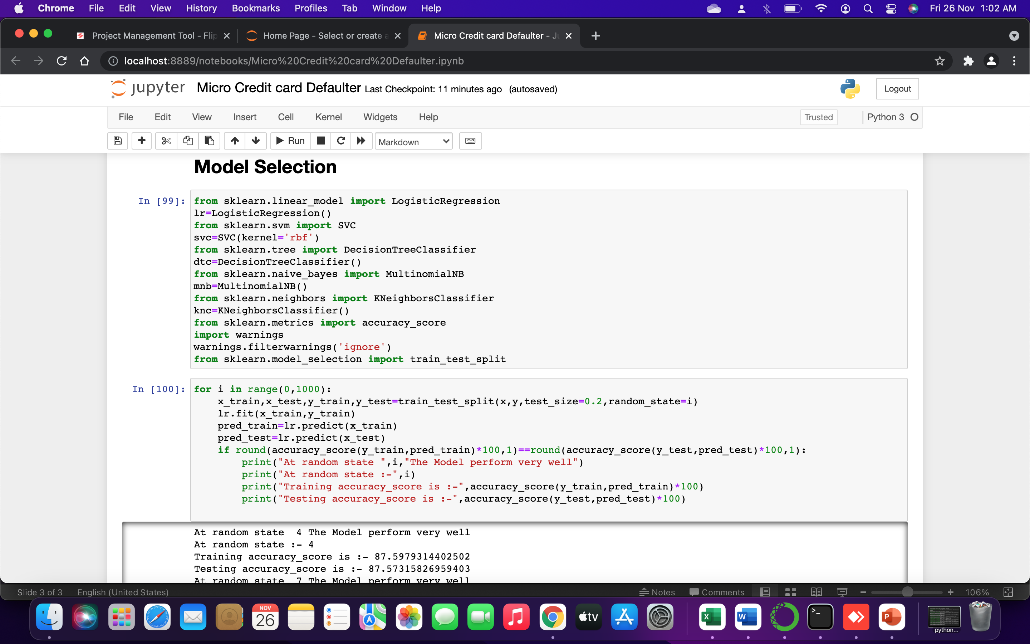
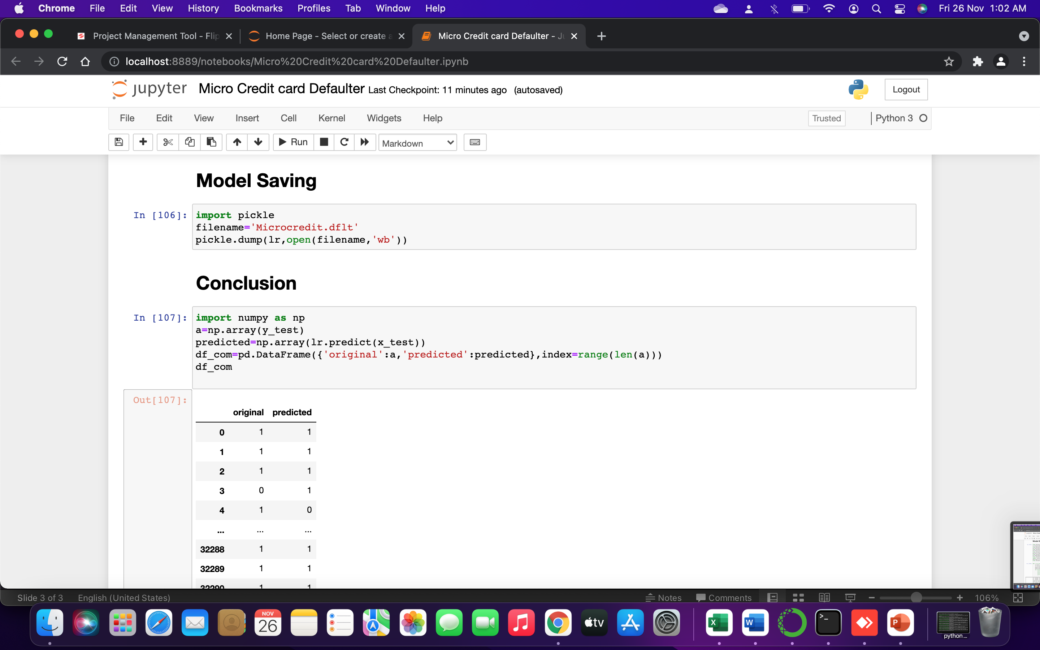
Conclusion and Model:-

